Slide 1
Module 7 Conduct procurement (Part 2)
Mgmt 6063 – Project Procurement

Slide 2

Module agenda
Module Learning Outcomes
Understand the key components of a contract
Understand the purpose of purchase orders
Apply steps in seller selection
Explore examples of conflict of interest in procurement
Homework/evaluations
Notes:
Image https://www.sandler.com
Apply categories .....
Understand the advantages ...
Use of Function Points ...
Work with 3-point estimates,...
Discern the various reasons ...
Calculate ...
Develop ...
Evaluate ...
Extract ...
Recognize ...

Slide 3
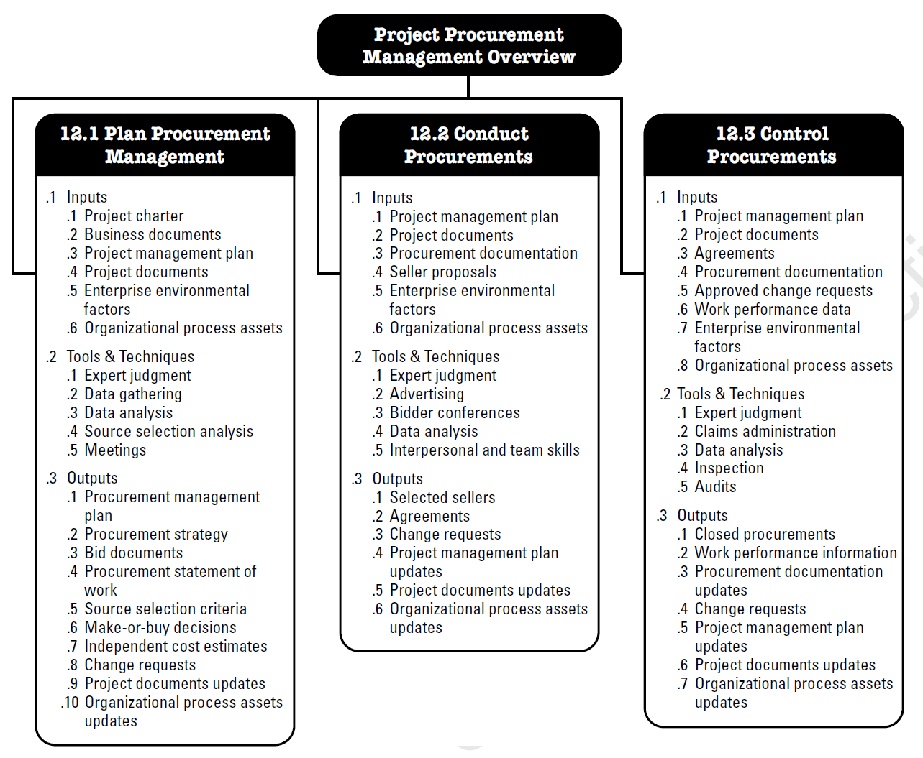
Project procurement management conduct procurement
Started last module:
Conduct Procurement The process of obtaining seller responses, selecting a seller, and awarding a contract. End results: established agreements including formal contracts.
Notes:
Image - Project Management Institute, Inc., PMBOK Guide 6th Edition (2017)

Slide 4
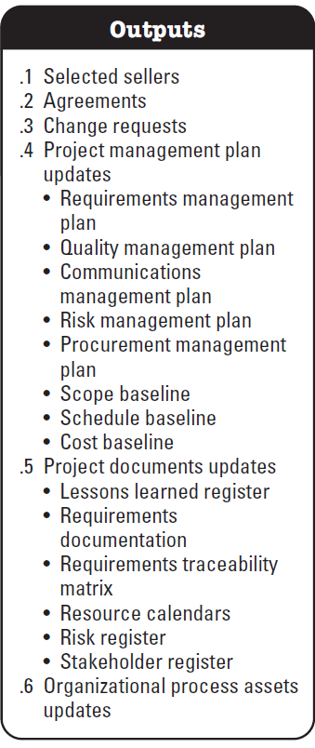
conduct procurement outputs
Agreements
The legal document in place that obligates the seller to provide the specified products, services, or results.
We looked at several types of contracts in the last module, but what specifics are included in a contract?
Notes:
Image - Project Management Institute, Inc., PMBOK Guide 6th Edition (2017)
Image http://osianafitri.blogspot.com/2017/04/what-is-negotiation-rejection-and.html
Definition Retrieved from https://blog.bit.ai/procurement-management-plan/ on 20210429

Slide 5
Contract content
The major components in a contract will vary, and may include but are not limited to:
Procurement statement of work or major deliverables
Schedule, milestones, or date by which a schedule is required
Performance reporting
Pricing and payment terms
Inspection, quality, and acceptance criteria
Warranty and future product support
Incentives and penalties
Insurance and performance bonds
Subordinate subcontractor approvals
General terms and conditions
Change request handling
Termination clause and alternative dispute resolution mechanisms
Recall some of this terminology in the M6 contract term matching exercise

Slide 6
Online – find a real contract for a service/product/result
What type of product, service or result is the contract for?
Which of the following items does it include?
Procurement statement of work or major deliverables
Schedule, milestones, or date by which a schedule is required
Performance reporting
Pricing and payment terms
Inspection, quality, and acceptance criteria
Warranty and future product support
Incentives and penalties
Insurance and performance bonds
Subordinate subcontractor approvals
General terms and conditions
Change request handling
Termination clause and alternative dispute resolution mechanisms.
Handout or Word doc

Slide 7
conduct procurement outputs
Agreements
The legal document in place that obligates the seller to provide the specified products, services, or results.
We looked at several types of contracts in the last module, but what are purchase orders?
Notes:
Image - Project Management Institute, Inc., PMBOK Guide 6th Edition (2017)
Image http://osianafitri.blogspot.com/2017/04/what-is-negotiation-rejection-and.html
Definition Retrieved from https://blog.bit.ai/procurement-management-plan/ on 20210429

Slide 8
Purchase orders (PO)
A purchase order (PO) is a legally binding document created by a buyer and presented to a seller. It lays out the order details, including quantity and types of products the buyer needs, as well as payment terms and delivery details.
A PO may or may not involve an existing contract.
Generally includes:
Purchase order number
Product or service being purchased
Seller name, contact information, and billing address
Buyer’s name, contact information, and shipping address
The quantity of the order, including the unit of measurement
Price per unit
Sales taxes
Total price
The delivery date
Shipping method
Shipping terms and conditions

Slide 9
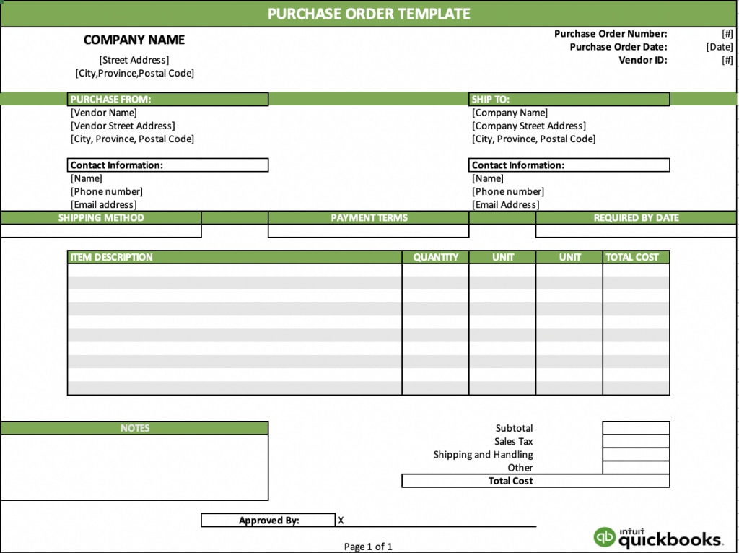
Purchase orders (PO)
Notes:
Image and reference quickbooks.intuit.com

Slide 10
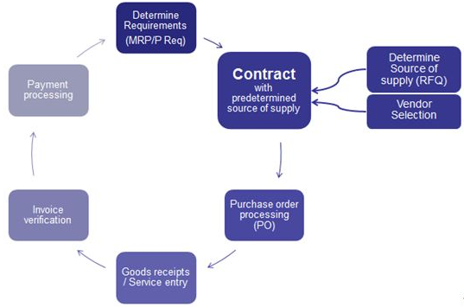
Purchase orders (PO)
When a PO relates to a contract:
Example: Company ABC has selected Designers-R-Us to provide office design services over the next five years as the organization expands across Canada. A contract is in place between the two parties. A PO will be issued to Designers-R-Us for each office design work package.
Notes:
Image https://blogs.sap.com/2012/10/03/brief-overview-of-outline-agreements/

Slide 11
Online – find a real purchase order
Does the purchase order relate to a contract or does it stand alone?
Which of the following items does it include?:
Purchase order number
Product or service being purchased
Seller name, contact information, and billing address
Buyer’s name, contact information, and shipping address
The quantity of the order, including the unit of measurement
Price per unit
Sales taxes
Total price
The delivery date
Shipping method
Shipping terms and conditions
Handout or Word doc

Slide 12
Choosing the seller
Recall from the last module:
Tool and techniques included proposal evaluation (under data analysis)
Outputs included selected sellers
So, HOW do we choose the seller?

Slide 13
Proposal evaluation
Evaluate the seller submissions based on the evaluation criteria in the procurement documents. They may include:
Mandatory elements
Seller understanding of need
Overall proposed cost by seller
Seller’s approach to risk management and project management
Seller’s technical approach to the project
Seller’s qualifications (e.g., specific relevant experience, key staff qualifications and/or experience, seller’s financial stability, knowledge transfer including training)
Previous client references
Your project team members, subject matter experts or others in your organization may contribute to the evaluation.

Slide 14
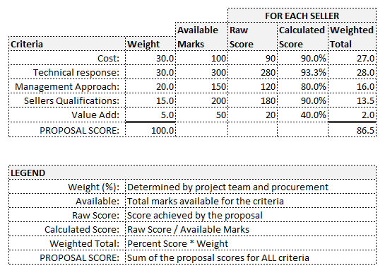
Sample submission evaluation

Slide 15
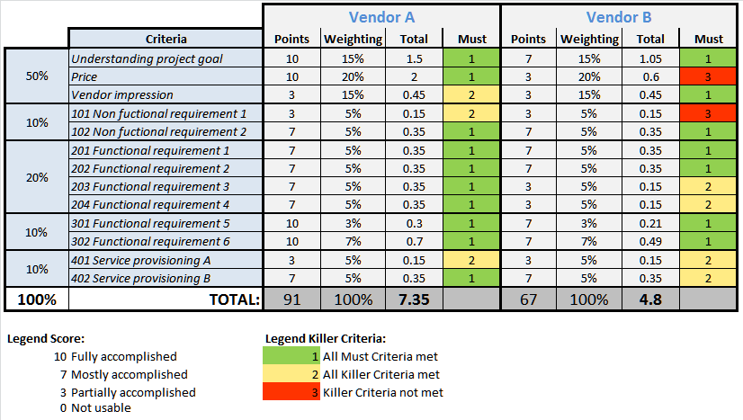
Sample submission evaluation
Notes:
Image https://blog.itil.org/2012/07/six-steps-for-a-successful-vendor-selection/

Slide 16

Conflicts of interest in procurement
Conflict of interest can be introduced in procurement in multiple ways including:
Members of the seller’s submission evaluation team are potentially biased in their evaluation
Dealing with bidders with unequal access to information (i.e., unfair advantage).
How to avoid conflicts of interest
(4:43min).
Click here.
As an individual, or in a group, find a real life online example of conflict of interest in procurement. What was the situation? What was the outcome? What could/should have been done differently?
Notes:
Some reference from https://www.mondaq.com/canada/government-contracts-procurement-ppp/257736/conflicts-of-interest-in-procurement

Slide 17
Summary of our journey today
Components of a contract
Purchase orders
Seller selection
Conflict of interest

Slide 18
Homework and evaluations
Readings for next module as listed in Course Overview
Midterm exam

Slide 19
references
Project Management Institute (2017). A Guide to the Project Management Body of Knowledge (Sixth Edition).
Kerzner, Harold (2017). Project Management, Twelfth Edition.
Watts, A. (2014). Project Management. Victoria, B.C.:BCcampus. Retrieved from https://opentextbc.ca/projectmanagement/.

